Slide 1
Carolina Brew
E.T.L Project
Melinda Eudy,
Kelly Rose, and
Darrius Summers

Slide 2
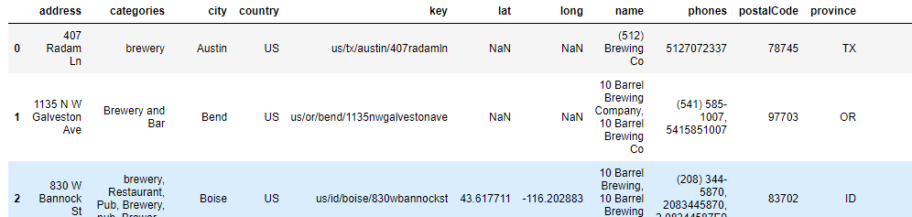
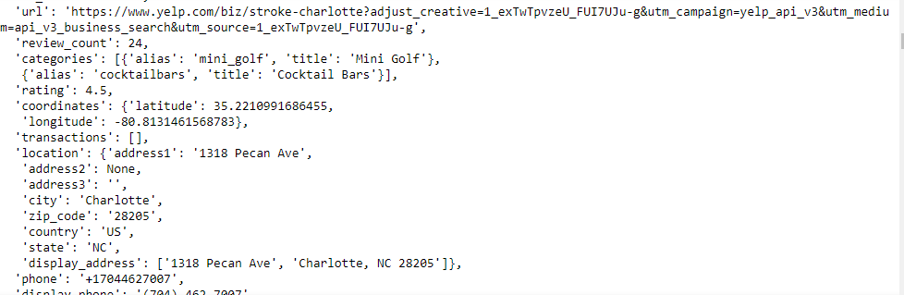
Extraction
Data sets:
KAGGLE - BREWERIES AND BEER PUBS IN THE US (.CSV)
'https://api.yelp.com/v3/businesses/search’ (NC)
'https://api.yelp.com/v3/businesses/search’ (SC)
Initial Files:

Slide 3
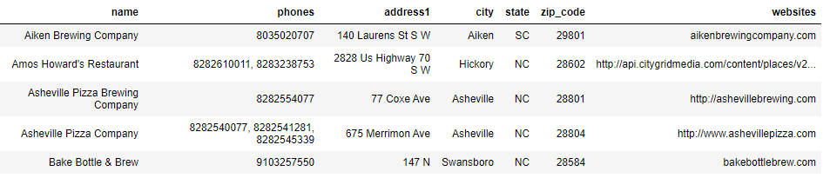
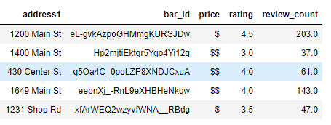
Transform
Kaggle file: remove columns, renamed columns, reorganized columns, removed rows with Nan and finally, sorted to North and South Carolina
Final Result: 77 Bars
Yelp file: created a list of rows of interest—address, bar id, price, rating, and number of reviews. Then placed into a pandas DataFrame.
Final Result : 20 Bars NC & 20 Bars SC

Slide 4
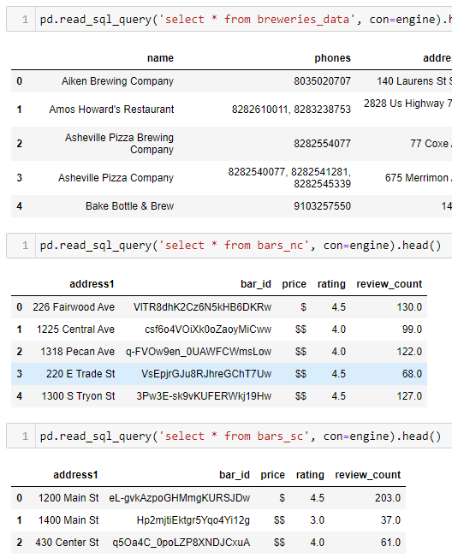
Transform
Sent tables to postgres – pgAdmin4
Confirmed all tables loaded

Slide 5
Transform
Added

Slide 6
Load

Slide 7
Conclusion

